Slide 1

School Database Management System - SMS -

Slide 2

SQL Language
What Is a SQL Database?
SQL stands for Structured Query Language.
It's used for relational databases.
A SQL database: is a collection of tables that stores
a specific set of structured data.

Slide 3

Introduction
Why we need to create a school management system (SMS)?
The school management system project addresses the
needs of every issue that happens in the school. The
issues could include difficulty in tracing students’
attendance, managing their information, and monitoring
the students’ performances.

Slide 4

Problem Statement
What is a problem with traditional school management?
It didn’t have a systematic way to store information about
students. When the staff or administrator wants to record
the data of a student, they have to fill out a paper form.
The data might be lost if there are a lot of problems at the
same time.

Slide 5

Objectives
Why we need to create a school management system (SMS)?
(SMS): Is developed to help staff do less work, help students,
and teachers save time, cut costs, and improve data security.
All of these things will eventually make your institution more
cost-effective and productive. It is also able to secure important
data of students and educators that every educational institution
needs.

Slide 6

SMS ER Diagram

Slide 7
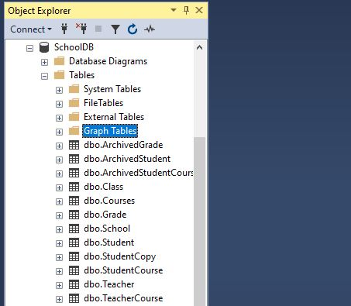
School Management System Tables

Slide 8
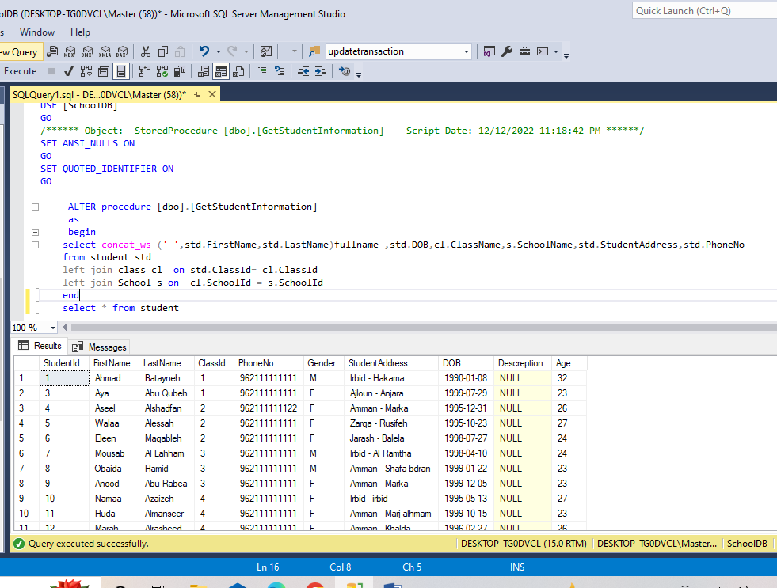
SQL Query
Retrieve all student information.

Slide 9


